Slide 1
IS 4420
Database Fundamentals
Chapter 7:
Introduction to SQL
Leon Chen

Slide 2
Systems Development Life Cycle
Database Development Process
Project Identification
and Selection
Enterprise modeling
Project Initiation
and Planning
Conceptual data modeling
Analysis
Logical Design
Logical database design
Physical Design
Physical database design and definition
Implementation
Database implementation
Maintenance
Database maintenance

Slide 3
Part Four: Implementation
Chapter 7 – Introduction to SQL
Chapter 8 – Advanced SQL
Chapter 9 – Client/Server Environment
Chapter 10 – Internet
Chapter 11 – Data Warehousing

Slide 4
Overview
Define a database using SQL data definition language
Work with Views
Write single table queries
Establish referential integrity

Slide 5
SQL Overview
Structured Query Language
The standard for relational database management systems (RDBMS)
SQL-92 and SQL-99 Standards – Purpose:
  Specify syntax/semantics for data definition and manipulation
  Define data structures
  Enable portability
  Specify minimal (level 1) and complete (level 2) standards
  Allow for later growth/enhancement to standard

Slide 6
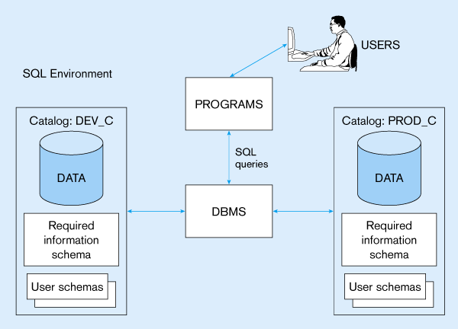

Slide 7
SQL Environment
Catalog
  A set of schemas that constitute the description of a database
Schema
  The structure that contains descriptions of objects created by a user (base tables, views, constraints)
Data Definition Language (DDL)
  Commands that define a database, including creating, altering, and dropping tables and establishing constraints
Data Manipulation Language (DML)
  Commands that maintain and query a database
Data Control Language (DCL)
  Commands that control a database, including administering privileges and committing data

Slide 8
SQL Data types
(from Oracle 9i)
String types
  CHAR(n) – fixed-length character data, n characters long Maximum length = 2000 bytes
  VARCHAR2(n) – variable length character data, maximum 4000 bytes
  LONG – variable-length character data, up to 4GB. Maximum 1 per table
Numeric types
  NUMBER(p,q) – general purpose numeric data type
  INTEGER(p) – signed integer, p digits wide
  FLOAT(p) – floating point in scientific notation with p binary digits precision
Date/time type
  DATE – fixed-length date/time in dd-mm-yy form

Slide 9
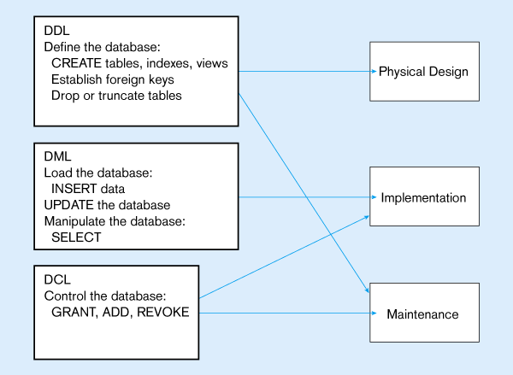

Slide 10
SQL Database Definition
Data Definition Language (DDL)
Major CREATE statements:
  CREATE SCHEMA – defines a portion of the database owned by a particular user
  CREATE TABLE – defines a table and its columns
  CREATE VIEW – defines a logical table from one or more views
Other CREATE statements: CHARACTER SET, COLLATION, TRANSLATION, ASSERTION, DOMAIN

Slide 11
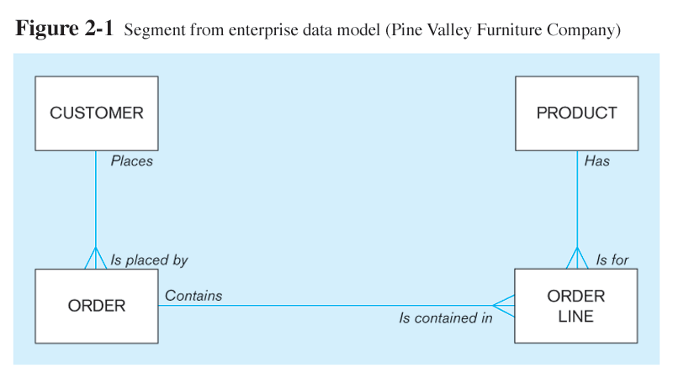
The following slides create tables for this enterprise data model

Slide 12
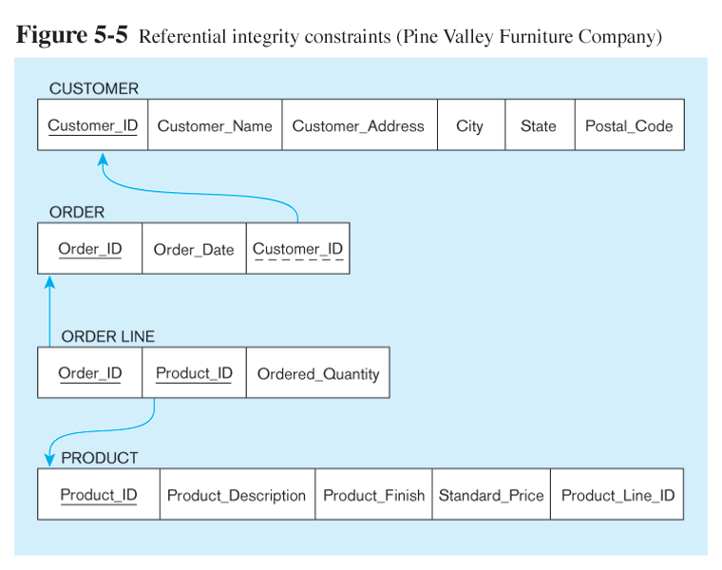
Relational Data Model

Slide 13
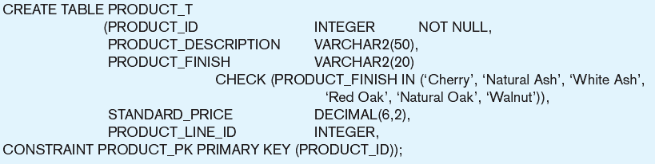
Create PRODUCT table
Non-nullable specification
Primary keys can never have NULL values
Identifying primary key

Slide 14
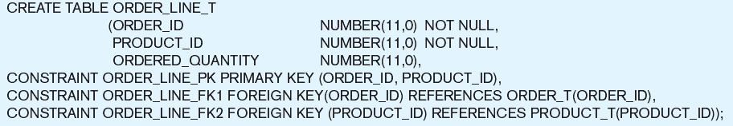
Non-nullable specifications
Primary key
Some primary keys are composite – composed of multiple attributes

Slide 15
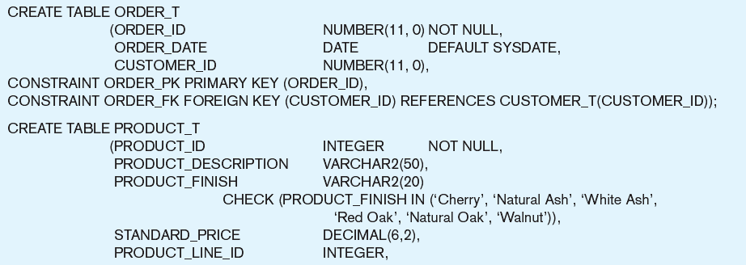
Controlling the values in attributes
Default value
Domain constraint

Slide 16
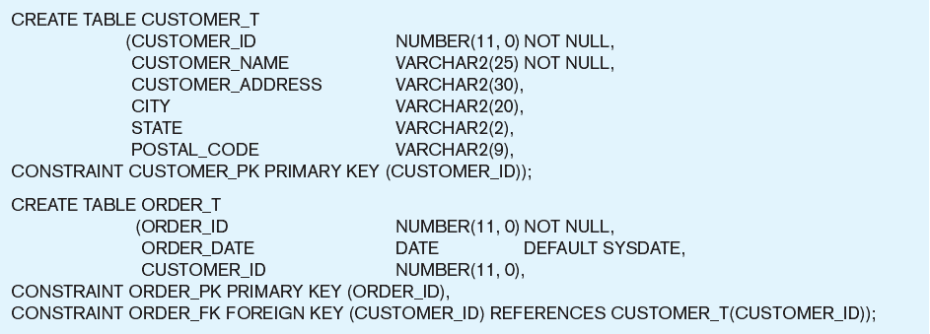
Identifying foreign keys and establishing relationships
Primary key of parent table
Foreign key of dependent table

Slide 17
Data Integrity Controls
Referential integrity – constraint that ensures that foreign key values of a table must match primary key values of a related table in 1:M relationships
Restricting:
  Deletes of primary records
  Updates of primary records
  Inserts of dependent records

Slide 18
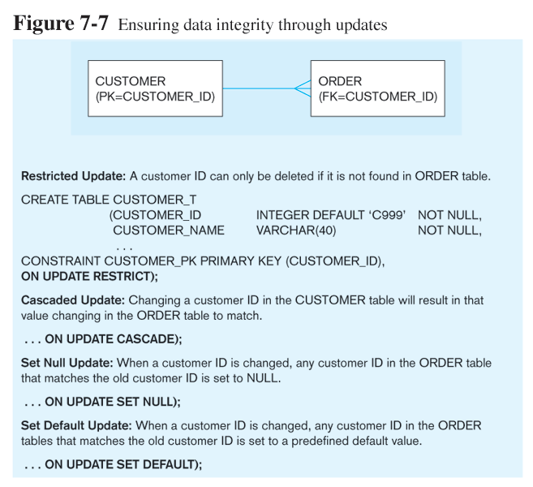

Slide 19
Using and Defining Views
Views provide users controlled access to tables
Base Table – table containing the raw data
Dynamic View
  A “virtual table” created dynamically upon request by a user
  No data actually stored; instead data from base table made available to user
  Based on SQL SELECT statement on base tables or other views
Materialized View
  Copy or replication of data
  Data actually stored
  Must be refreshed periodically to match the corresponding base tables

Slide 20
Sample CREATE VIEW
  CREATE VIEW EXPENSIVE_STUFF_V AS
  SELECT PRODUCT_ID, PRODUCT_NAME, UNIT_PRICE
  FROM PRODUCT_T
  WHERE UNIT_PRICE >300
  WITH CHECK_OPTION;
View has a name
View is based on a SELECT statement
CHECK_OPTION works only for updateable views and prevents updates that would create rows not included in the view

Slide 21
Advantages of Views
Simplify query commands
Assist with data security (but don't rely on views for security, there are more important security measures)
Enhance programming productivity
Contain most current base table data
Use little storage space
Provide customized view for user
Establish physical data independence

Slide 22
Disadvantages of Views
Use processing time each time view is referenced
May or may not be directly updateable

Slide 23
Create Four Views
CREATE VIEW CUSTOMER_V AS SELECT * FROM CUSTOMER_T;
CREATE VIEW ORDER_V AS SELECT * FROM ORDER_T;
CREATE VIEW ORDER_LINE_V AS SELECT * FROM ORDER_LINE_T;
CREATE VIEW PRODUCT_V AS SELECT * FROM PRODUCT_T;
‘*’ is the wildcard

Slide 24
Changing and Removing Tables
ALTER TABLE statement allows you to change column specifications:
  ALTER TABLE CUSTOMER_T ADD (TYPE VARCHAR(2))
DROP TABLE statement allows you to remove tables from your schema:
  DROP TABLE CUSTOMER_T

Slide 25
Schema Definition
Control processing/storage efficiency:
  Choice of indexes
  File organizations for base tables
  File organizations for indexes
  Data clustering
  Statistics maintenance
Creating indexes
  Speed up random/sequential access to base table data
  Example
    CREATE INDEX NAME_IDX ON CUSTOMER_T(CUSTOMER_NAME)
    This makes an index for the CUSTOMER_NAME field of the CUSTOMER_T table

Slide 26
Insert Statement
Adds data to a table
Inserting a record with all fields
  INSERT INTO CUSTOMER_T VALUES (001, ‘Contemporary Casuals’, 1355 S. Himes Blvd.’, ‘Gainesville’, ‘FL’, 32601);
Inserting a record with specified fields
  INSERT INTO PRODUCT_T (PRODUCT_ID, PRODUCT_DESCRIPTION, PRODUCT_FINISH, STANDARD_PRICE, PRODUCT_ON_HAND) VALUES (1, ‘End Table’, ‘Cherry’, 175, 8);
Inserting records from another table
  INSERT INTO CA_CUSTOMER_T SELECT * FROM CUSTOMER_T WHERE STATE = ‘CA’;

Slide 27
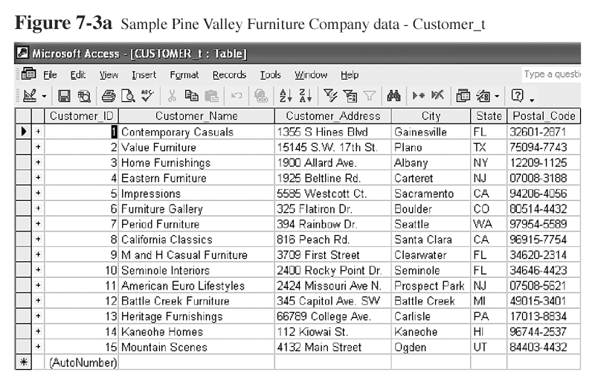

Slide 28
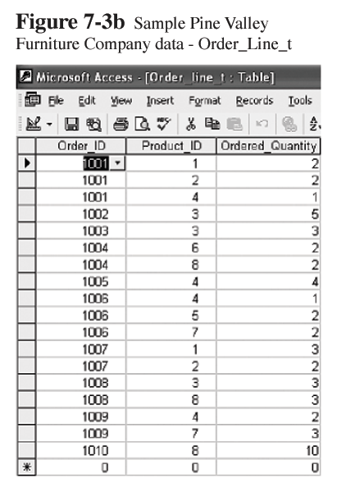

Slide 29
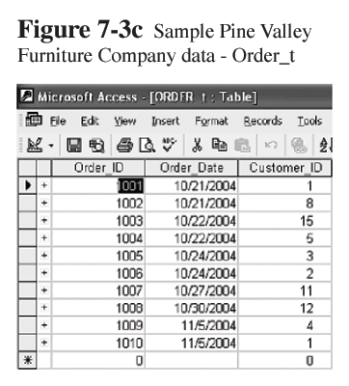

Slide 30
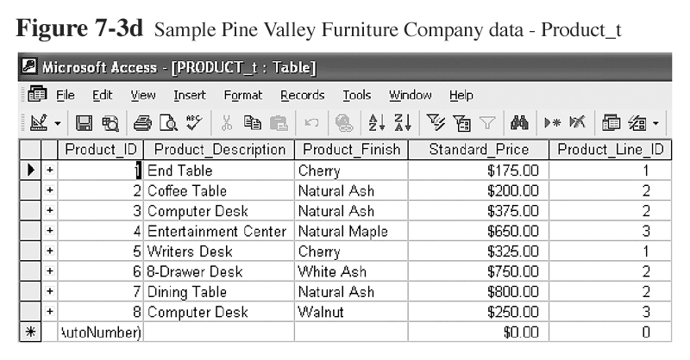

Slide 31
Delete Statement
Removes rows from a table
Delete certain rows
  DELETE FROM CUSTOMER_T WHERE STATE = ‘HI’;
Delete all rows
  DELETE FROM CUSTOMER_T;

Slide 32
Update Statement
Modifies data in existing rows
UPDATE PRODUCT_T SET UNIT_PRICE = 775 WHERE PRODUCT_ID = 7;

Slide 33
SELECT Statement
Used for queries on single or multiple tables
Clauses of the SELECT statement:
  SELECT
    List the columns (and expressions) that should be returned from the query
  FROM
    Indicate the table(s) or view(s) from which data will be obtained
  WHERE
    Indicate the conditions under which a row will be included in the result
  GROUP BY
    Indicate columns to group the results
  HAVING
    Indicate the conditions under which a group will be included
  ORDER BY
    Sorts the result according to specified columns

Slide 34
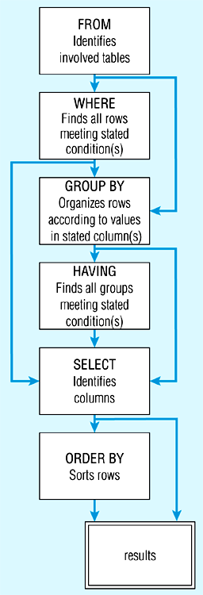
Figure 7-8: SQL statement processing order

Slide 35
SELECT Example
Find products with standard price less than $275
  SELECT PRODUCT_NAME, STANDARD_PRICE
  FROM PRODUCT_V
  WHERE STANDARD_PRICE < 275;
Product table

Slide 36
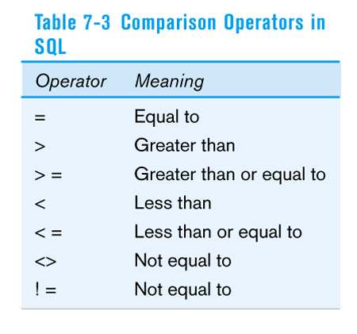

Slide 37
SELECT Example using Alias
Alias is an alternative column or table name
    SELECT CUST.CUSTOMER AS NAME, CUST.CUSTOMER_ADDRESS
    FROM CUSTOMER_V CUST
    WHERE NAME = ‘Home Furnishings’;

Slide 38
SELECT Example
Using a Function
Using the COUNT aggregate function to find totals
Aggregate functions: SUM(), MIN(), MAX(), AVG(), COUNT()
  SELECT COUNT(*) FROM ORDER_LINE_V
  WHERE ORDER_ID = 1004;
Order line table

Slide 39
SELECT Example – Boolean Operators
AND, OR, and NOT Operators for customizing conditions in WHERE clause
  SELECT PRODUCT_DESCRIPTION, PRODUCT_FINISH, STANDARD_PRICE
  FROM PRODUCT_V
  WHERE (PRODUCT_DESCRIPTION LIKE ‘%Desk’
  OR PRODUCT_DESCRIPTION LIKE ‘%Table’)
  AND UNIT_PRICE > 300;
Note: the LIKE operator allows you to compare strings using wildcards. For example, the % wildcard in ‘%Desk’ indicates that all strings that have any number of characters preceding the word “Desk” will be allowed

Slide 40
SELECT Example –
Sorting Results with the ORDER BY Clause
Sort the results first by STATE, and within a state by CUSTOMER_NAME
  SELECT CUSTOMER_NAME, CITY, STATE
  FROM CUSTOMER_V
  WHERE STATE IN (‘FL’, ‘TX’, ‘CA’, ‘HI’)
  ORDER BY STATE, CUSTOMER_NAME;
Note: the IN operator in this example allows you to include rows whose STATE value is either FL, TX, CA, or HI. It is more efficient than separate OR conditions

Slide 41
SELECT Example –
Categorizing Results Using the GROUP BY Clause
  SELECT STATE, COUNT(STATE)
  FROM CUSTOMER_V
  GROUP BY STATE;
  Note: you can use single-value fields with aggregate functions if they are included in the GROUP BY clause
Customer table

Slide 42
SELECT Example –
Qualifying Results by Categories
Using the HAVING Clause
For use with GROUP BY
  SELECT STATE, COUNT(STATE)
  FROM CUSTOMER_V
  GROUP BY STATE
  HAVING COUNT(STATE) > 1;
  Like a WHERE clause, but it operates on groups (categories), not on individual rows. Here, only those groups with total numbers greater than 1 will be included in final result

